Slide 1
Cloud Hybrid Engine Demo
Huawei Technologies

Slide 2
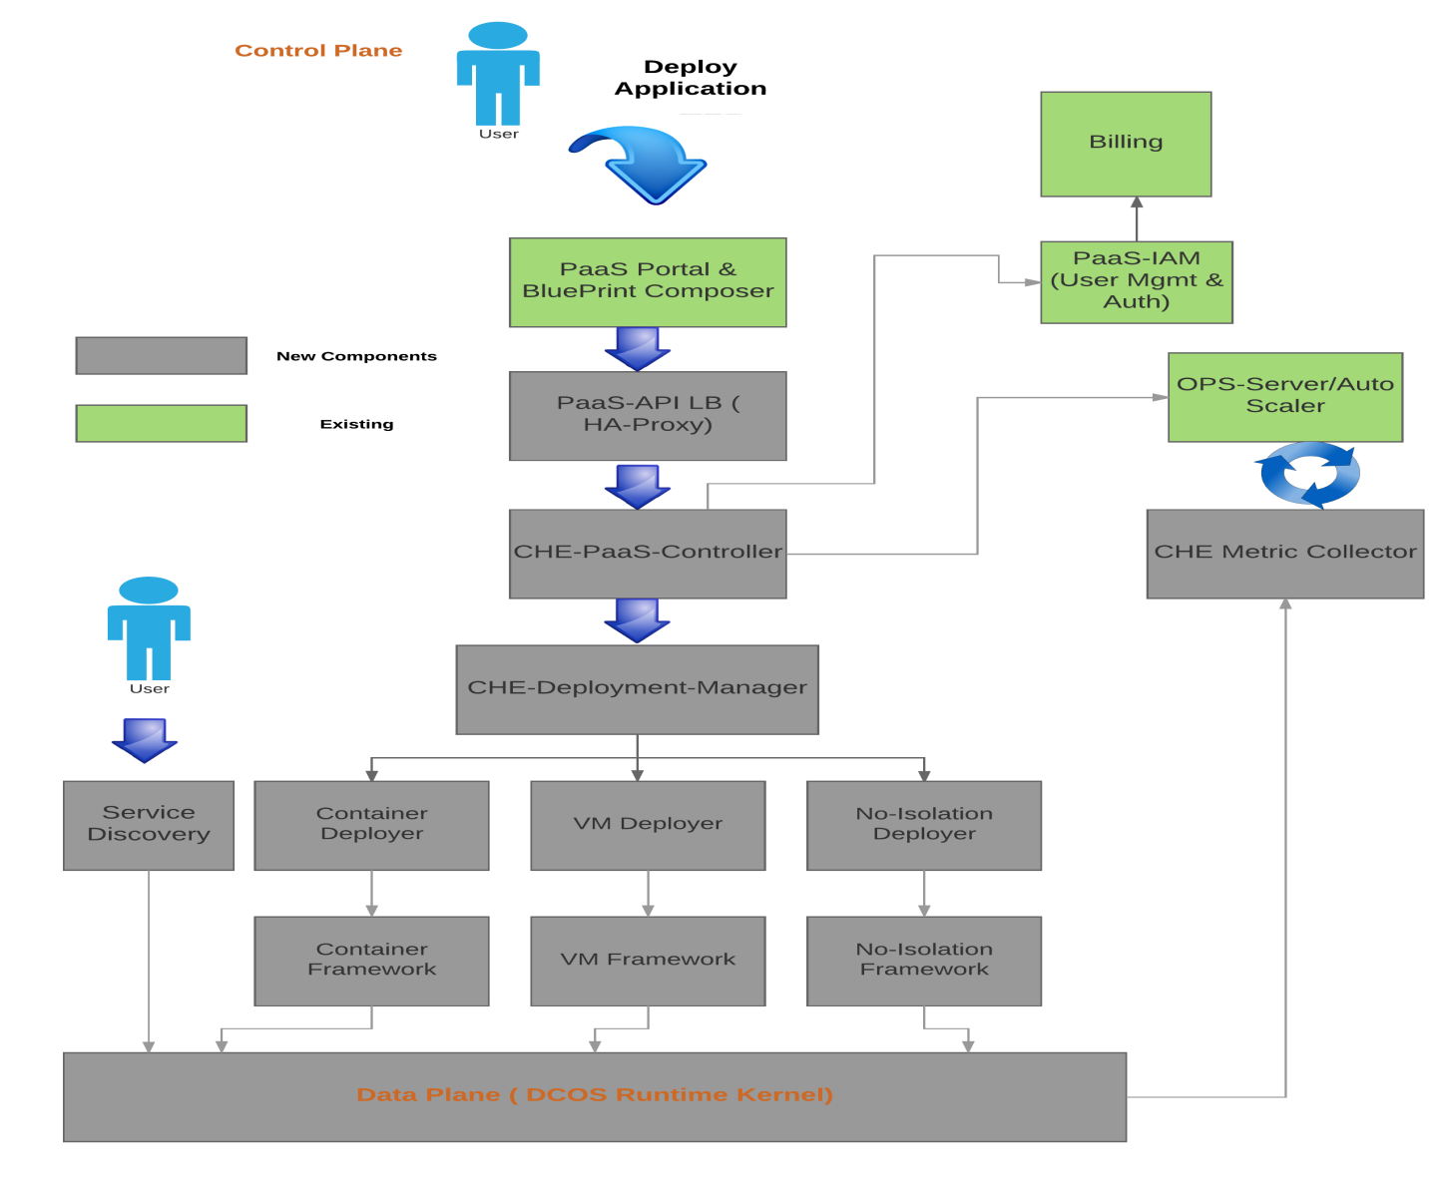
Design

Slide 3
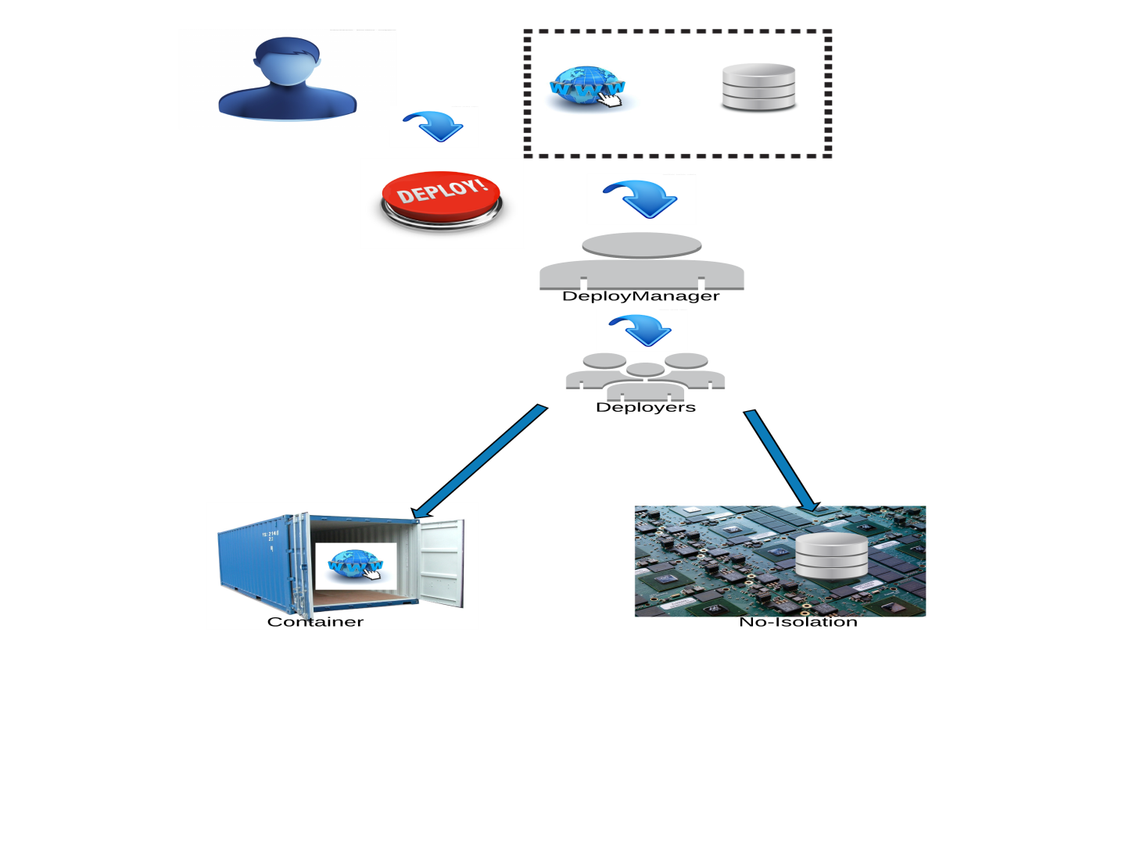

Slide 4

Demo

Slide 5
Contact
krishna.m.kumar@huawei.com
vinaym@huawei.com
shivram.srivastava@huawei.com
dhilip.kumar.s@huawei.com

